Slide 1
Why hire people with criminal backgrounds & how do to it
Facilitated by Dana Harrison

Slide 2
Agenda
Welcome
Mitigating risk
Unique advantages
Cultural awareness
Your company
Connecting with candidates
Supporting success
Resources (www.synergycs.net)
Q&A

Slide 3
Did you know?
Approximately 18% of Indiana residents (1.2 million) have a criminal record.
28% of adults in Marion County have a criminal conviction.

Slide 4
How big is your candidate pool?
Newly released
Probation
Parole
Work-release
Clean backgrounds
Blemished backgrounds
Incarcerated
PEN Industries
Susan Spangler (HR)
Barada & Associates
Safe Hiring Solutions

Slide 5
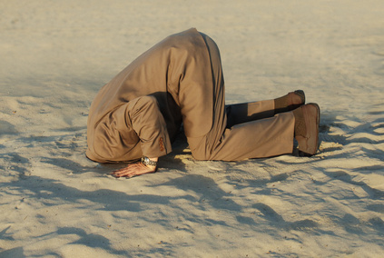
Mitigating Risk
Real talk about risks
Federal bonding

Slide 6
Employer Opportunities
Financial Benefits for Hiring
Work Opportunity Tax Credit (WOTC)
HIRED**
Training Dollars
Skills Enhancement Fund
Employer Training Grant
Workforce Training Grant (for individuals)
Candidate/Employee Support
Vetted candidates for no fee
Job coaches
Life help

Slide 7
Cultural Awareness

Slide 8
Your Company
The more of these characteristics your business has, the more likely you are to successfully employ ex-offenders.
people.
Reasonable screening process + positive candidate experiences
Clear roles + understanding of company needs
Clear employee expectations
Meaningful feedback
Coaching/mentoring approaches
Solid onboarding
Flexibility
Authentic appreciation of diversity

Slide 9
Candidates: Finding & Screening
Humble
Hungry
Smart
-Patrick Lencioni, The Ideal Team Player
Agencies:
PACE
RecycleForce
Department of Workforce Development/Workone
Edna Martin Christian Center,
StepUp
What to ask & not ask

Slide 10
Supporting Success
Connections at work matter
Feedback and coaching focused on their success
Agency relationship
Transportation

Slide 11
Q&A

Slide 12
Thank you
Find links to all references, contact information for panelists and additional information at:
www.synergycs.net

